Slide 1

15MU
Welcome to Fidelity’s fifteen Minute university
~
Policy Forms - Which One Should I Use?

Slide 2
Policy Forms –
Which One Should I Use?
QUESTIONS? COMMENTS? SUGGESTIONS?
Please email to: Polly.Campbell@fnf.com

Slide 3
There are two basic types of Insureds:
  Owners
  Lenders
There are two basic types of coverage:
  Standard coverage
  Enhanced Coverage

Slide 4
Standard Coverage:
  ALTA Owners Policy with Georgia Modifications (6/17/06)
  ALTA Loan Policy with Georgia Modifications (6/17/06)
  ALTA Short Form Residential Loan Policy with Georgia Modifications (6/17/07)

Slide 5
Enhanced Coverage:
ALTA Homeowners Policy of Title Insurance One-to-Four Family Residence (02-03-10)
ALTA Expanded Residential Loan Policy with Georgia Modifications (07-26-10)

Slide 6
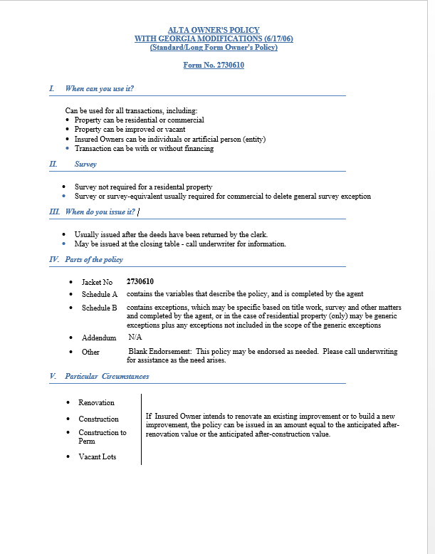
Standard Coverage:
ALTA Owners Policy with Georgia Modifications (6/17/06) (“Long Form Owners”) Jacket No 2730610
When can you use it?
“Universal” Policy - Can be used for all transactions

Slide 7
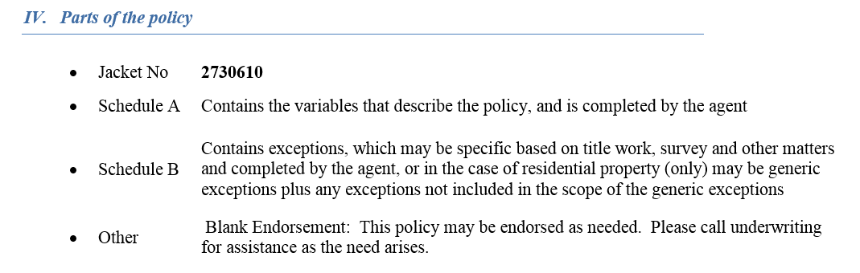
ALTA Owners Policy with Georgia Modifications (6/17/06) (“Long Form Owners”) Jacket No 2730610

Slide 8
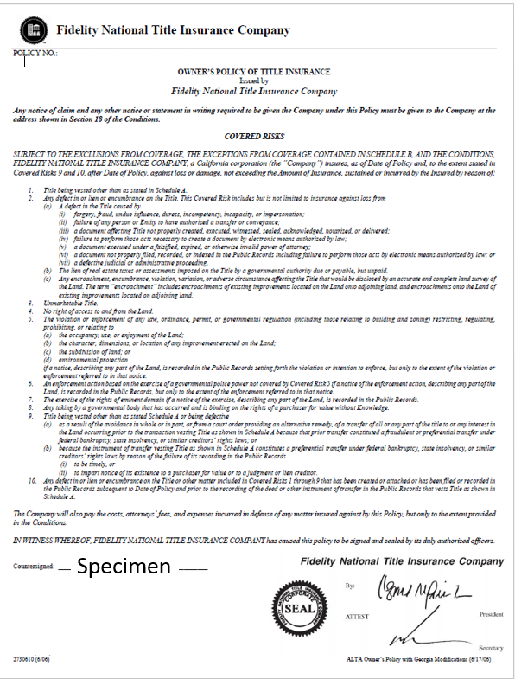
ALTA Owners Policy with Georgia Modifications (6/17/06)
(“Long Form Owners”)
Jacket No 2730610

Slide 9
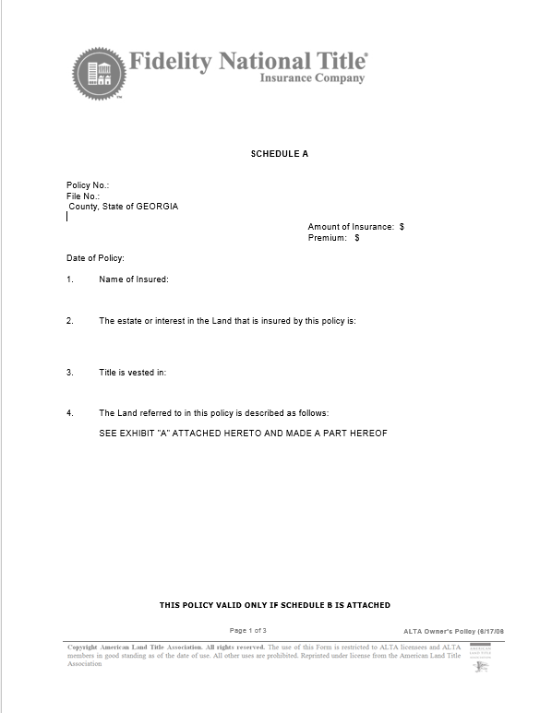
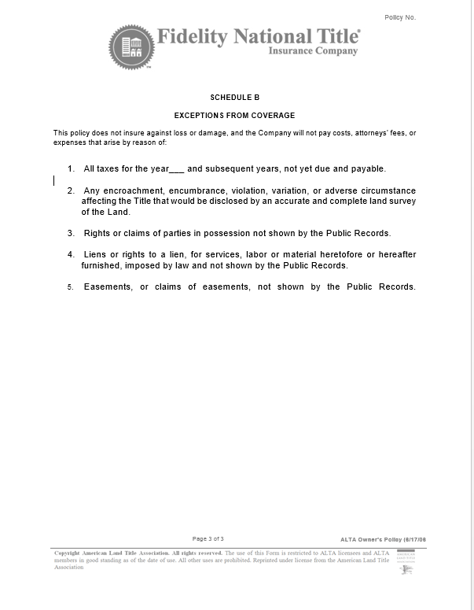
Schedule A and
Schedule B
ALTA Owners Policy with Georgia Modifications (6/17/06)
(“Long Form Owners”)
Jacket No 2730610

Slide 10
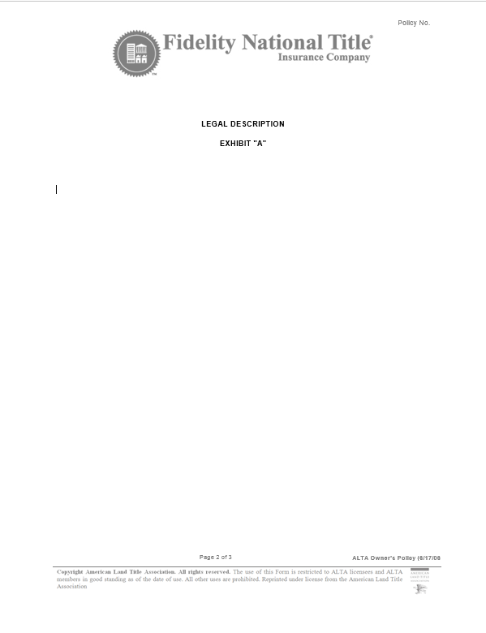
Exhibit “A” for
ALTA Owners Policy with Georgia Modifications (6/17/06)
(“Long Form Owners”)
Jacket No 2730610

Slide 11
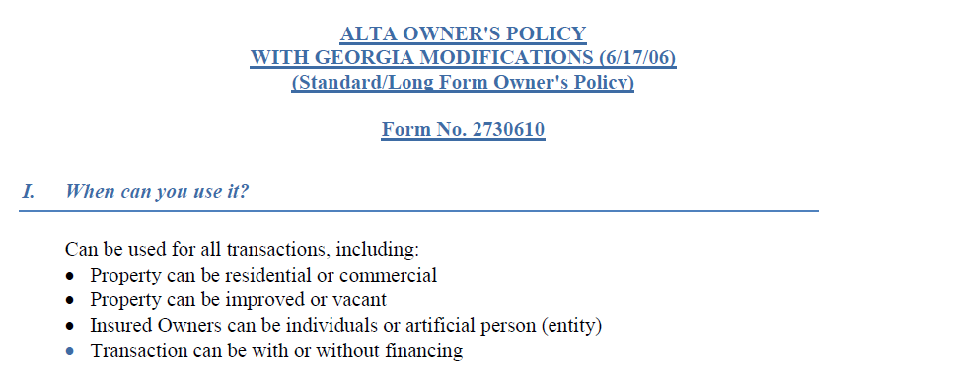
ALTA Owners Policy with Georgia Modifications (6/17/06) (“Long Form Owners”) Jacket No 2730610

Slide 12
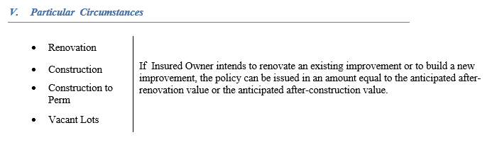
ALTA Owners Policy with Georgia Modifications (6/17/06) (“Long Form Owners”) Jacket No 2730610

Slide 13
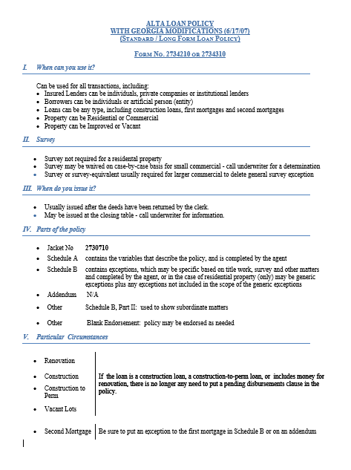
Standard Coverage:
ALTA Loan Policy with Georgia Modifications (6/17/06) (“Long Form Loan”) Jacket No 2730710
When can you use it?
“Universal” Policy - Can be used for all transactions

Slide 14
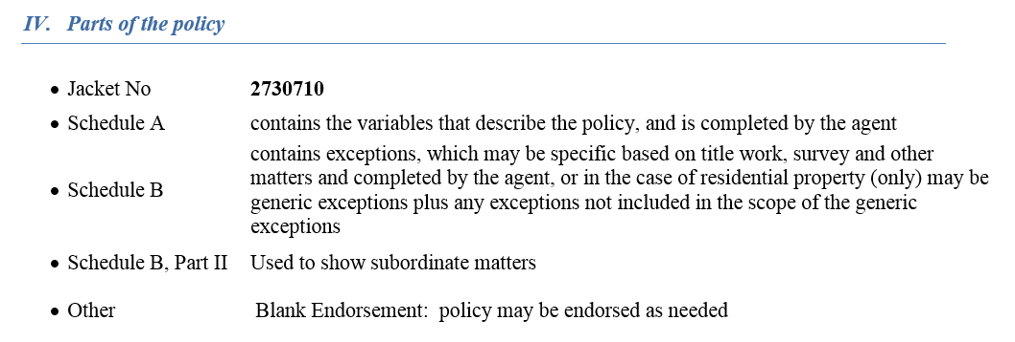
ALTA Loan Policy with Georgia Modifications (6/17/06) (“Long Form Loan”) Jacket No 2730710

Slide 15
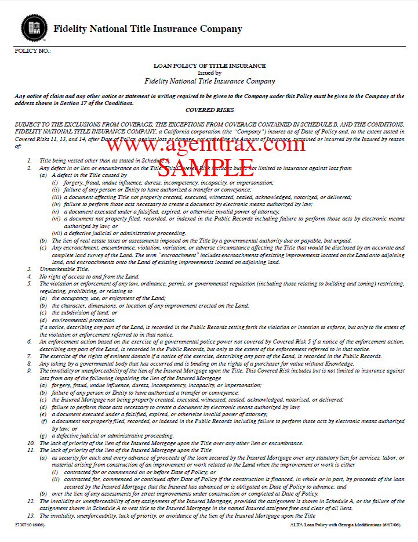
ALTA Loan Policy with Georgia Modifications (6/17/06)
(“Long Form Loan”)
Jacket No 2730710

Slide 16
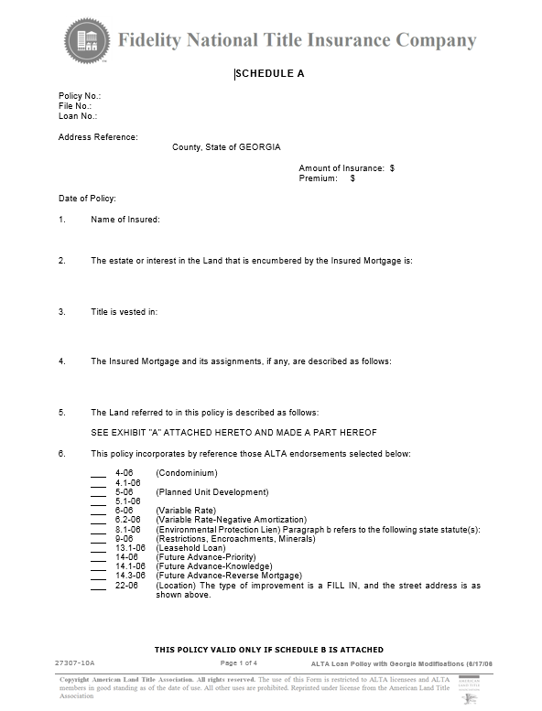
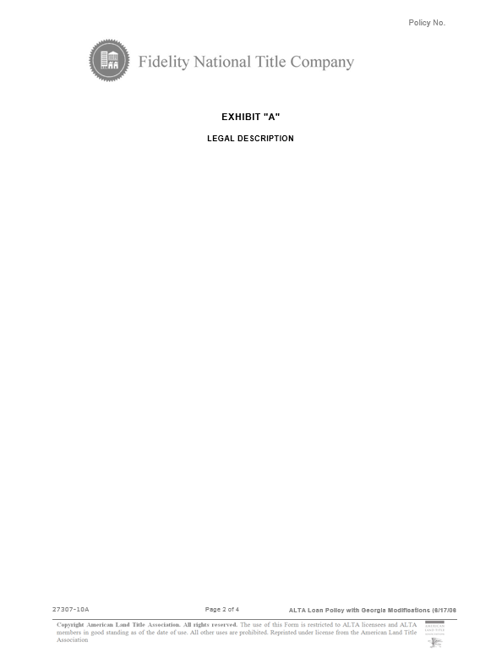
Schedule A and
Exhibit “A” for
ALTA
Loan Policy with Georgia Modifications (6/17/06)
(“Long Form Loan”)
Jacket No 2730710

Slide 17
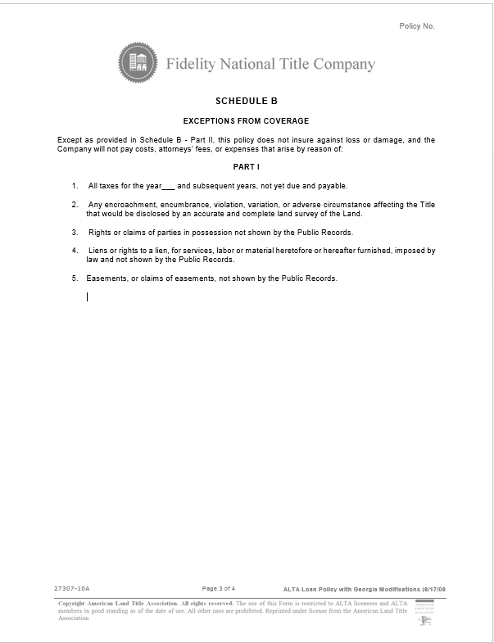
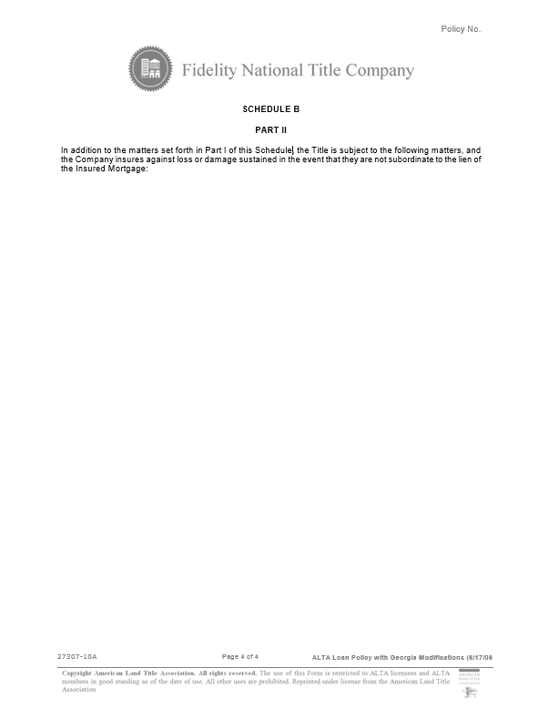
Schedule B
Part I
and
Schedule B
Part II
for
ALTA
Loan Policy with Georgia Modifications (6/17/06)
(“Long Form Loan”)
Jacket No 2730710

Slide 18
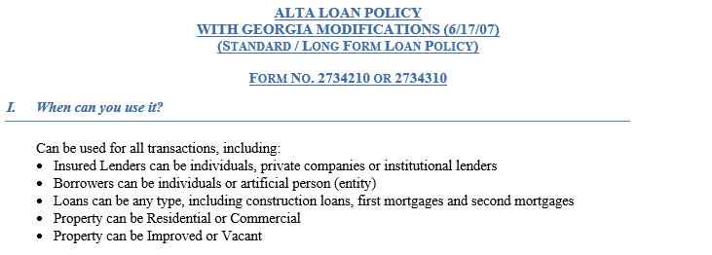
ALTA Loan Policy with Georgia Modifications (6/17/06) (“Long Form Loan”) Jacket No 2730710

Slide 19
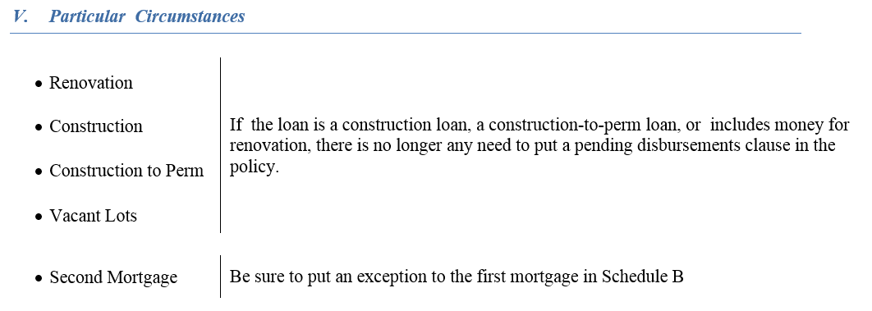
ALTA Loan Policy with Georgia Modifications (6/17/06) (“Long Form Loan”) Jacket No 2730710

Slide 20
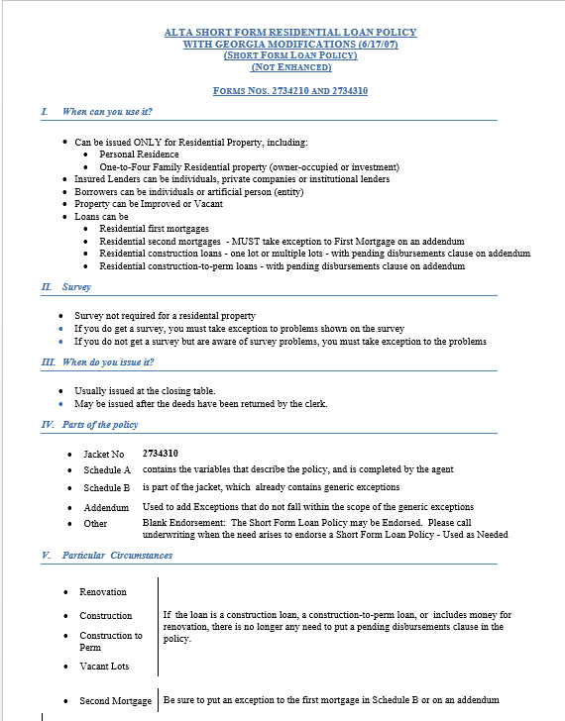
Standard Coverage:
ALTA Short Form Residential Loan Policy with Georgia Modifications (6/17/07) Jacket No 2734310
When can you use it?
Should be issued ONLY for Residential Property

Slide 21
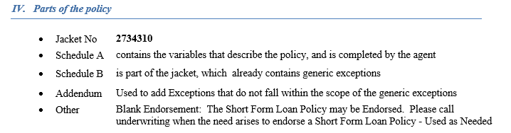
ALTA Short Form Residential Loan Policy with Georgia Modifications (6/17/07) Jacket No 2734310

Slide 22
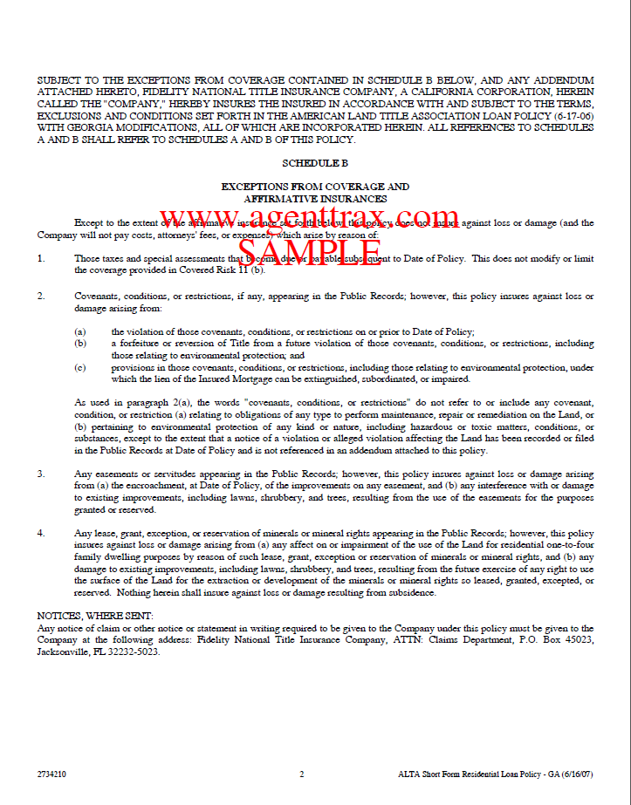
ALTA Short Form Residential Loan Policy with Georgia Modifications (6/17/07)
Jacket No 2734310

Slide 23
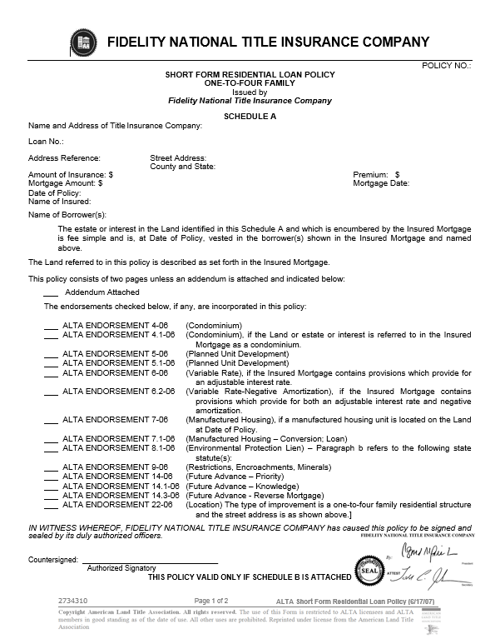
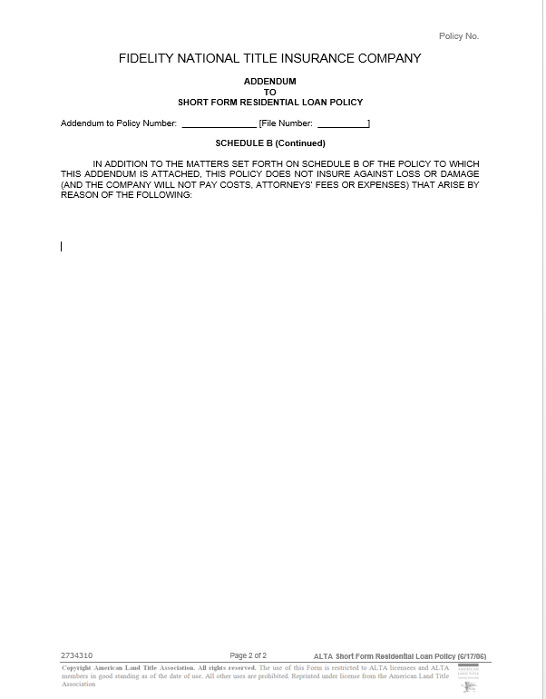
Schedule A and Addendum for
ALTA Short Form Residential Loan Policy with Georgia Modifications (6/17/07)
Jacket No 2734310

Slide 24
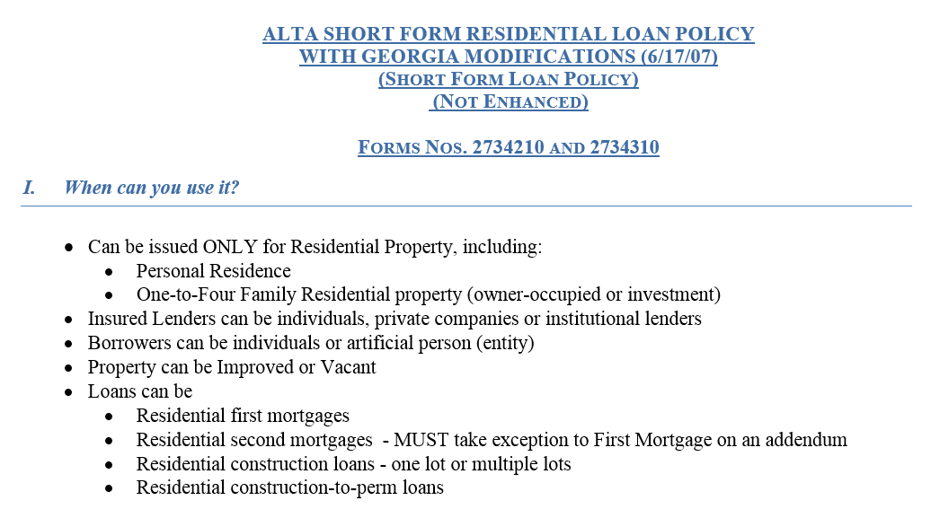
ALTA Short Form Residential Loan Policy with Georgia Modifications (6/17/07) Jacket No 2734310

Slide 25
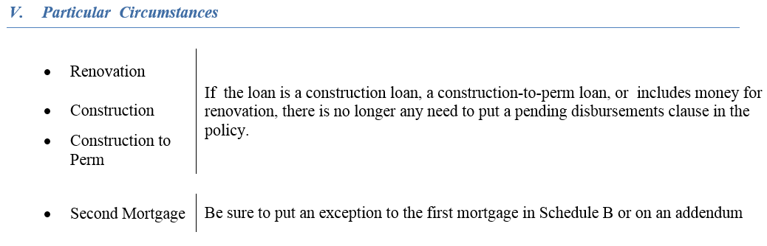
ALTA Short Form Residential Loan Policy with Georgia Modifications (6/17/07) Jacket No 2734310

Slide 26
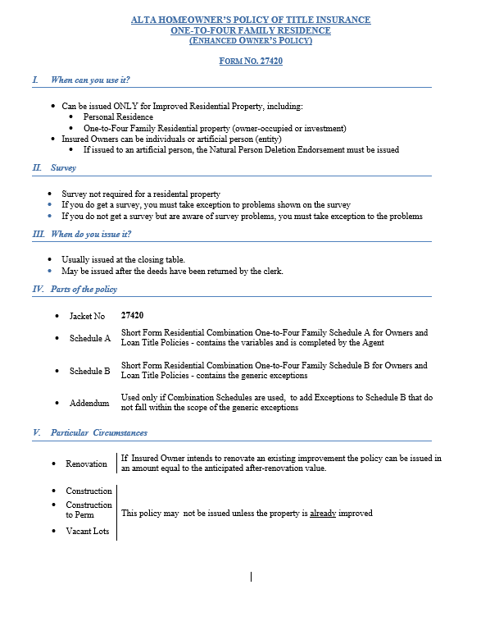
Enhanced Coverage
ALTA Homeowners Policy of Title Insurance (02/03/10) (“Enhanced” Owner’s) Jacket No 27420
When can you use it?
Can be issued ONLY for Improved Residential Property

Slide 27
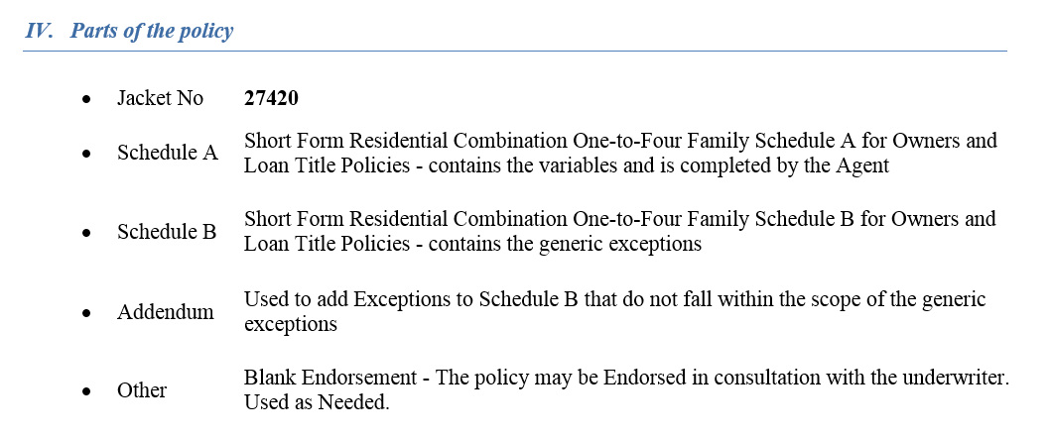
ALTA Homeowners Policy of Title Insurance (02/03/10) (“Enhanced” Owner’s) Jacket No 27420

Slide 28
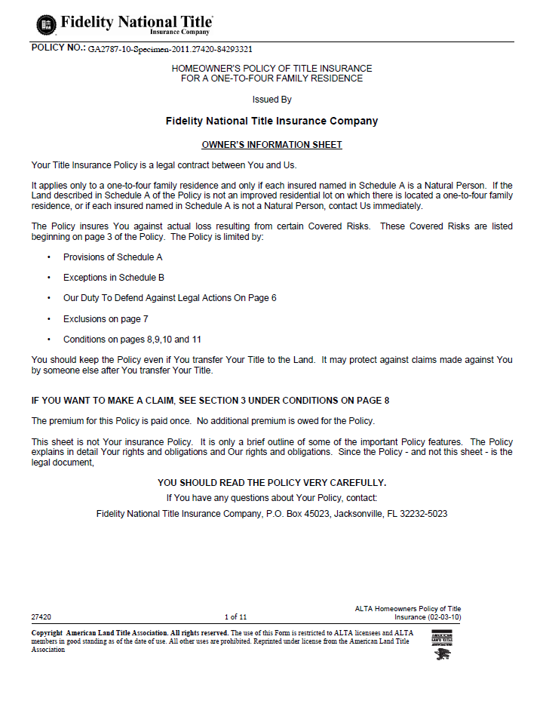
ALTA Homeowners Policy of Title Insurance (02/03/10)
(“Enhanced” Owner’s)
Jacket No 27420

Slide 29
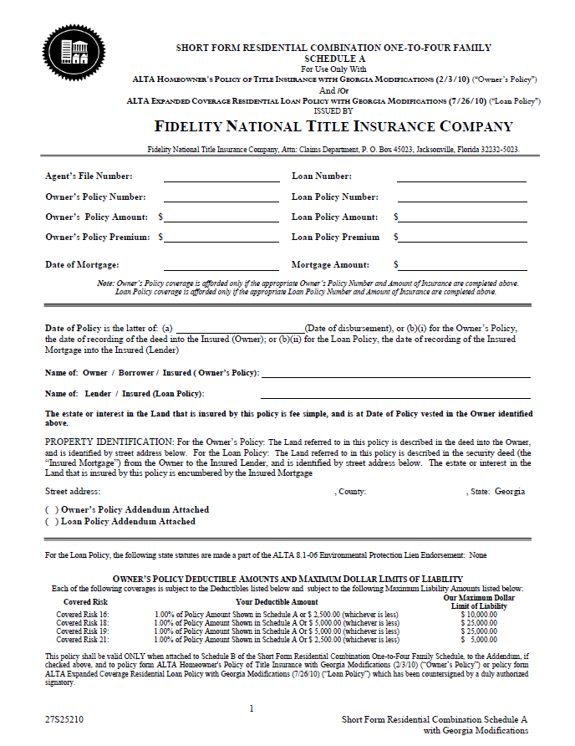
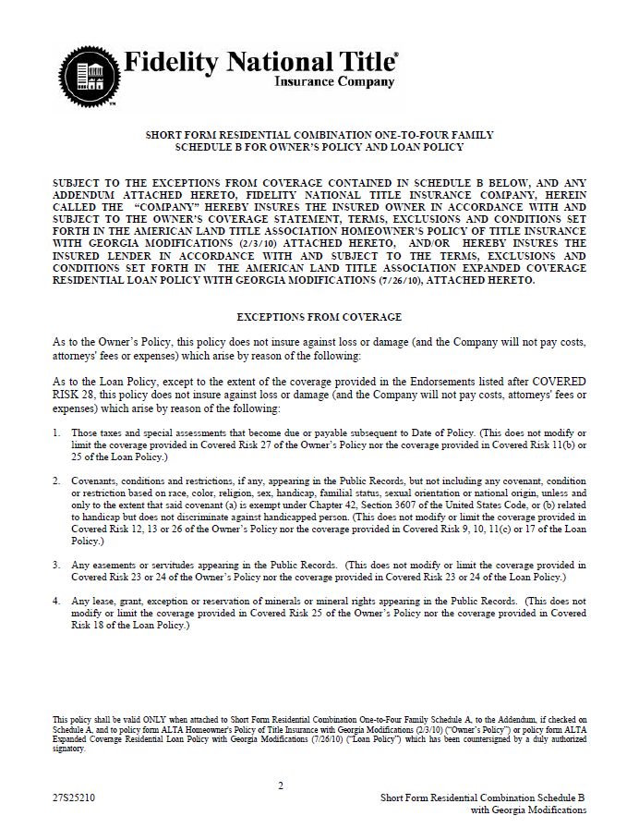
Combination Schedules for
ALTA Homeowners Policy of Title Insurance (02/03/10)
(“Enhanced” Owner’s)
Jacket No 27420

Slide 30
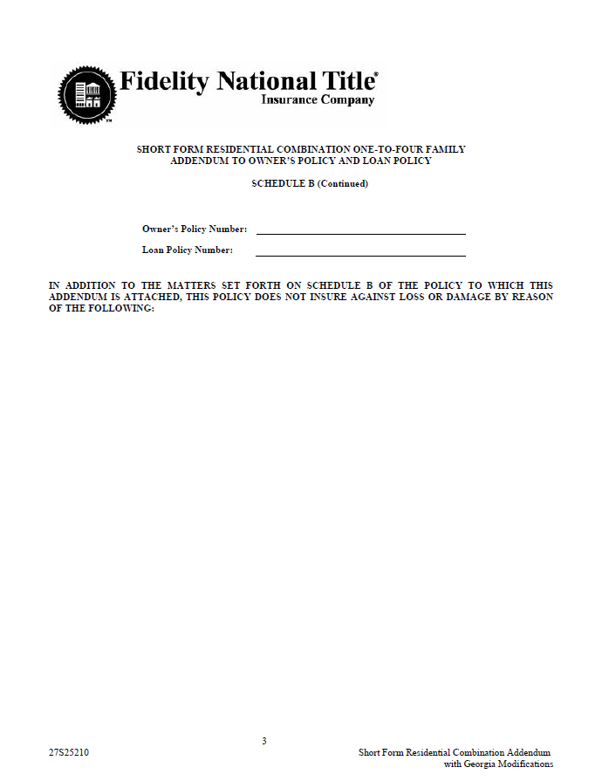
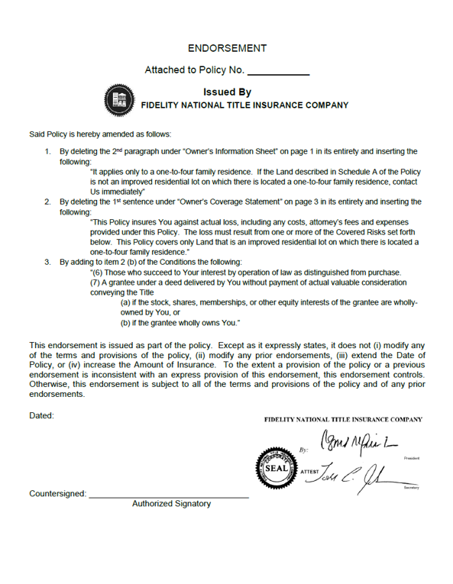
Combination Schedules for
ALTA Homeowners Policy of Title Insurance (02/03/10)
(“Enhanced” Owner’s)
Jacket No 27420

Slide 31
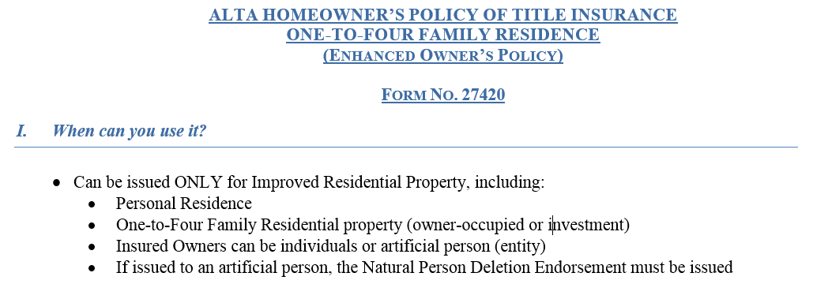
ALTA Homeowners Policy of Title Insurance (02/03/10) (“Enhanced” Owner’s) Jacket No 27420

Slide 32
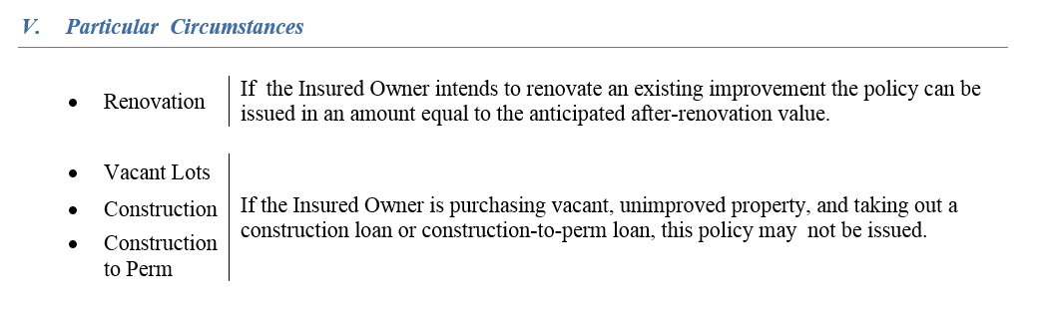
ALTA Homeowners Policy of Title Insurance (02/03/10) (“Enhanced” Owner’s) Jacket No 27420

Slide 33
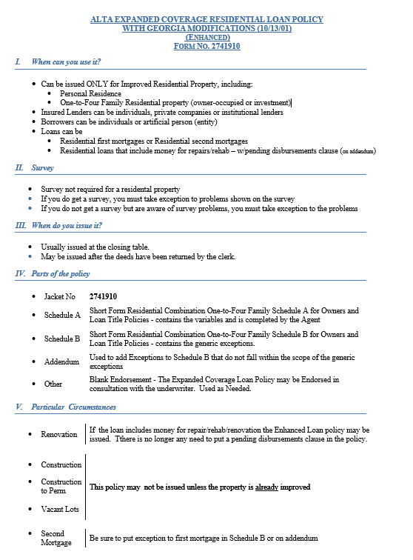
Enhanced Coverage
ALTA Expanded Coverage Residential Loan Policy with Georgia Modifications (07-26-10) (“Enhanced” Loan)
Jacket No 2741910
When can you use it?
  Can be issued ONLY for Improved Residential Property

Slide 34
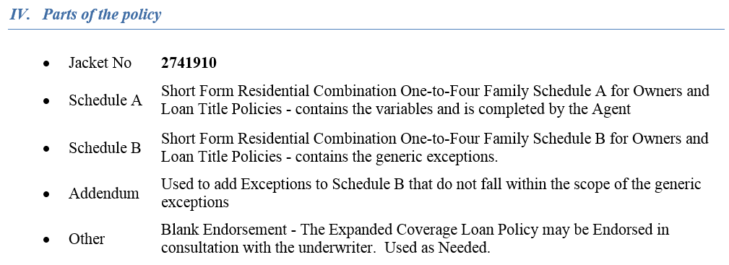
ALTA Expanded Coverage Residential Loan Policy with Georgia Modifications (07-26-10) (“Enhanced” Loan)
Jacket No 2741910

Slide 35
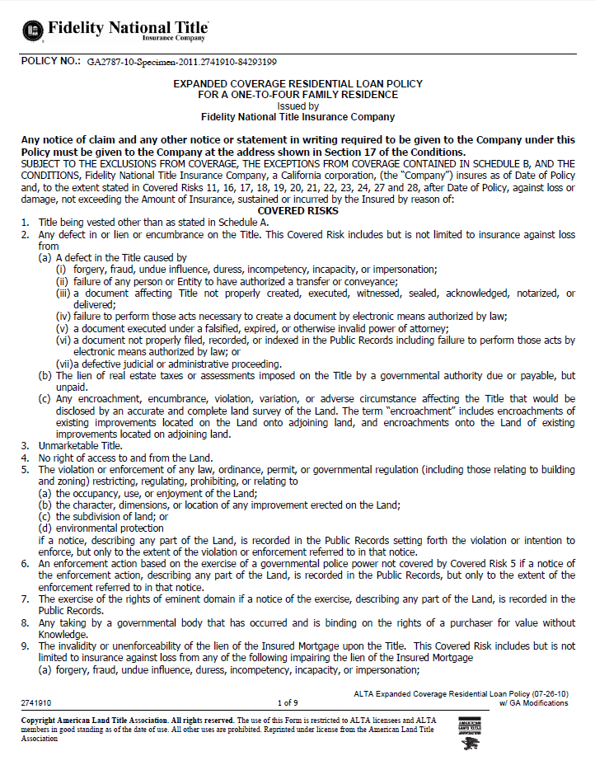
ALTA Expanded Coverage Residential Loan Policy with Georgia Modifications
(07-26-10)
(“Enhanced” Loan)
Jacket No 2741910

Slide 36
Combination Schedules for
ALTA Expanded Coverage Residential Loan Policy with Georgia Modifications
(07-26-10)
(“Enhanced” Loan)
Jacket No 2741910

Slide 37
Combination
Schedules for
ALTA Expanded Coverage Residential Loan Policy with Georgia Modifications
(07-26-10)
(“Enhanced” Loan)
Jacket No 2741910

Slide 38
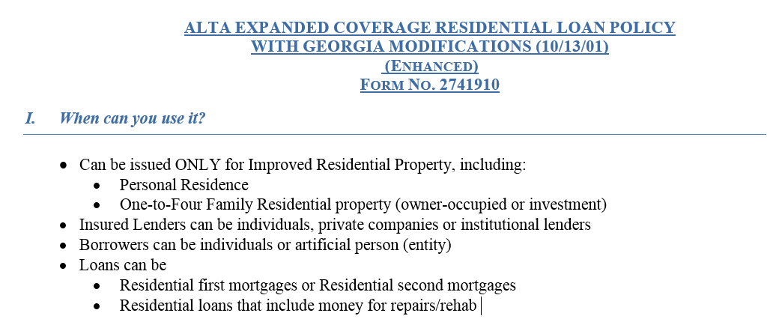
ALTA Expanded Coverage Residential Loan Policy with Georgia Modifications (07-26-10) (“Enhanced” Loan)
Jacket No 2741910

Slide 39
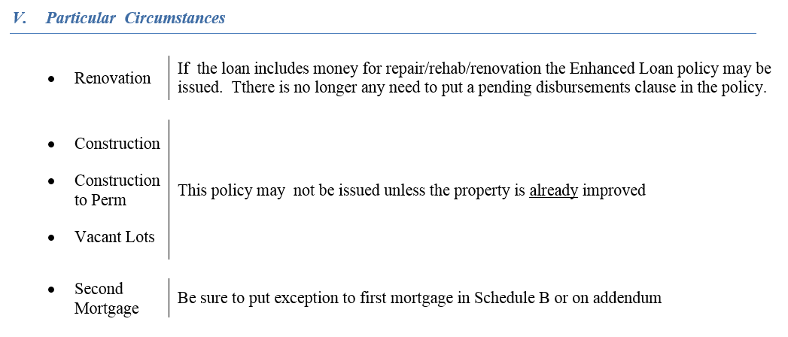
ALTA Expanded Coverage Residential Loan Policy with Georgia Modifications (07-26-10) (“Enhanced” Loan)
Jacket No 2741910

Slide 40
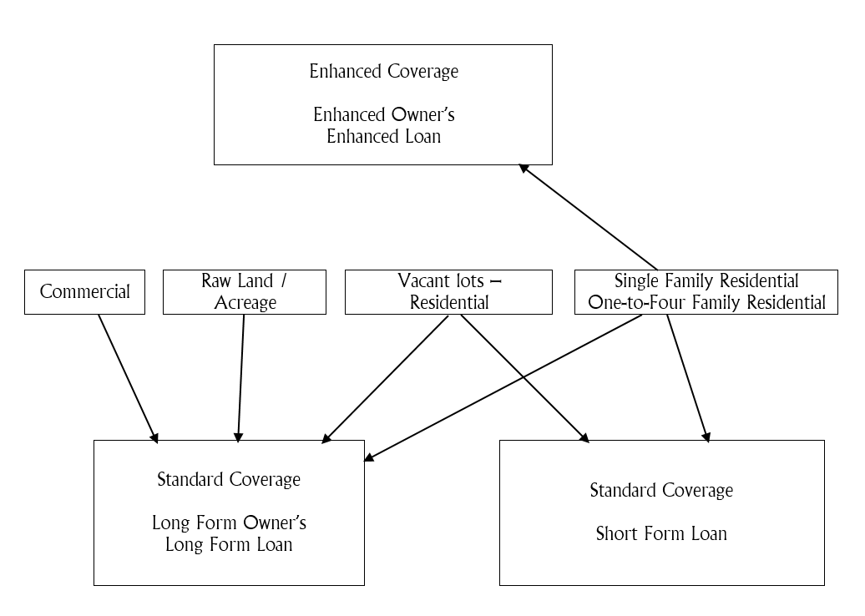

Slide 41

Thank you for attending this Fifteen Minute University
QUESTIONS? COMMENTS? SUGGESTIONS?
Please email to: Polly.Campbell@fnf.com

